Slide 1
FIREWALL
Basing
Configurations and Location

Slide 2
Firewall Basing
It is common to base a firewall on a stand-alone machine running a common operating system, such as UNIX or Linux.
Firewall functionality can also be implemented as a software module in a router or LAN switch.
            Firewall basing considerations
              Bastion Host
              Host-Based firewall
              Personal Firewall

Slide 3
Bastion Host
A bastion host is a system identified by the firewall administrator as a critical strong point in the network’s security.
The bastion host serves as a platform for an application-level or circuit-level gateway
      Characteristics of a bastion
      The bastion host hardware platform executes a secure version of its operating system, making it a hardened system.
      Only the services that the network administrator considers essential are installed on the bastion host. such as SMTP, FTP
      The bastion host may require additional authentication before a user is allowed access to the proxy services.
      Each proxy is configured to support only a subset of the standard application’s command set

Slide 4
  Each proxy maintains detailed audit information by logging all traffic, each connection, and the duration of each connection.
  Each proxy module is a very small software package specifically designed for
  network security.
  Each proxy is independent of other proxies on the bastion host. If there is a problem with the operation of any proxy, or if a future vulnerability is discovered,
  A proxy generally performs no disk access other than to read its initial configuration file.
  Each proxy runs as a non-privileged user in a private and secured directory on the bastion host.

Slide 5
Host-Based Firewalls
            A host-based firewall is a software module used to secure an individual host.
            Such modules are available in many operating systems or can be provided as an add-on package.
            A common location for such firewalls is a server

Slide 6
Advantages of a server-based or workstation based firewall
  Filtering rules can be tailored to the host environment.
  Specific corporate security policies for servers can be implemented, with different filters for servers used for different application.
  Protection is provided independent of topology. Thus both internal and external attacks must pass through the firewall.
  Used in conjunction with stand-alone firewalls, the host-based firewall provides an additional layer of protection.
    A new type of server can be added to the network, with its own firewall, without the necessity of altering the network firewall configuration.

Slide 7
Personal Firewall
A personal firewall controls the traffic between a personal computer or workstation on one side and the Internet or enterprise network on the other side. This firewall is basically a software on a person computer.
In a home environment with multiple computers connected to the Internet, firewall functionality can also be housed in a router that connects all of the home computers to a DSL, cable modem, or other Internet interface.

Slide 8
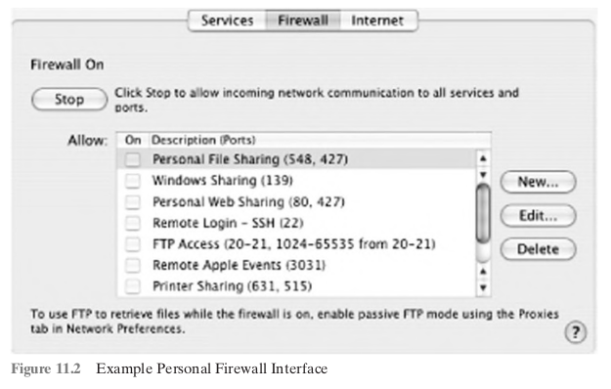
The primary role of the personal firewall is to deny unauthorized remote access to the computer.
The firewall can also monitor outgoing activity in an attempt to detect and block worms and other malware.
In bound services that can be permitted
-Personal file sharing (548, 427)
- Windows sharing (139)
- Personal Web sharing (80, 427)
- Remote login - SSH (22)
- FTP access (20-21, 1024-64535 from 20-21)
- Remote Apple events (3031)
- Printer sharing (631, 515)
- IChat Rendezvous (5297, 5298)
- ITunes Music Sharing (3869)
- CVS (2401)

Slide 9
For increased protection, advanced firewall features are available through easy-to-configure checkboxes.
UDP packets can be blocked, restricting network traffic to TCP packets only for open ports.
The firewall also supports logging, an important tool for checking on unwanted activity.

Slide 10
Firewall Configurations and Location

Slide 11
DMZ Networks
Virtual Private Networks
Distributed Firewalls
1
2
3

Slide 12
DMZ
Networks
demilitarized zone
1

Slide 13
An external firewall is placed at the edge of a local or enterprise network, just inside the boundary router that connects to the Internet or some wide area network (WAN).
In a typical enterprise network, one or more internal firewalls are set up to protect it against possible attacks.
Systems that are externally accessible but need some protection are located in DMZ network.
The systems in the DMZ require connectivity such as a corporate Web site, an e-mail server, or a DNS (domain name system) server.

Slide 14
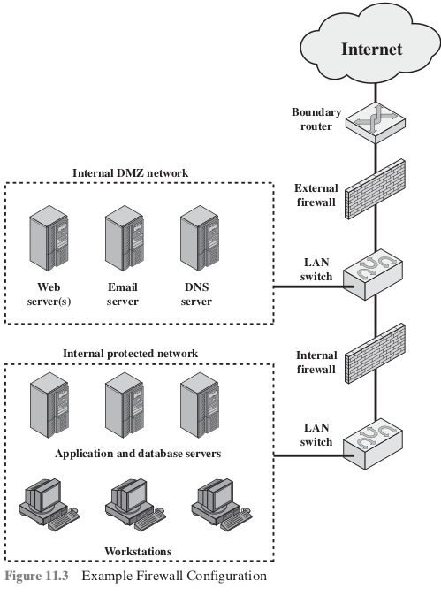
The external firewall provides a measure of access control and protection for the DMZ systems consistent with their need for external connectivity.
Purposes of Internal Firewall
Adds more stringent filtering capabilities.
The internal firewall provides two-way protection with respect to the DMZ.
  attacks launched from DMZ systems.
  attack from the internal protected network.
Multiple internal firewalls can be used to protect portions of the internal network from each other.

Slide 15
Virtual Private Networks
The VPN consists of a set of computers that interconnect by means of a relatively unsecure network and that make use of encryption and special protocols to provide security.
2

Slide 16
Use of a public network exposes corporate traffic to eavesdropping and provides an entry point for unauthorized users.
A VPN uses encryption and authentication in the lower protocol layers to provide a secure connection through an otherwise insecure network, typically the Internet
VPNs are generally cheaper than real private networks using private lines but rely on having the same encryption and authentication system at both ends.
The VPN encryption maybe performed by the firewall software. IPsec is the protocol mechanism used to ensure VPN encryption
If IPsec is implemented behind to the firewall, then the firewall will be unable to perform filtering, access control, logging or viruses scanning. Implementing Ipsec in boundary router, outside firewall will make device less secure

Slide 17
Public Network
A VPN uses encryption and authentication in the lower protocol layers to provide a secure connection through an otherwise insecure network, typically the Internet
Cost
IPsec
Encryption
Use of a public network exposes corporate traffic to eavesdropping and provides an entry point for unauthorized users.
VPNs are generally cheaper than real private networks using private lines but rely on having the same encryption and authentication system at both ends
The VPN encryption maybe performed by the firewall software. IPsec is the protocol mechanism used to ensure VPN encryption
Virtual Private Network

Slide 18
Distributed Firewalls
A distributed firewall configuration involves stand-alone firewall devices plus host-based firewalls working together under a central administrative control.
3

Slide 19
Administrators can configure host resident firewalls on hundreds of servers and workstations as well as configure personal firewalls on local and remote user systems.
Tools let the network administrator set policies and monitor security across the entire network.
These firewalls protect against internal attacks and provide protection tailored to specific machines and applications.
Stand-alone firewalls provide global protection, including internal firewalls and an external firewall

Slide 20
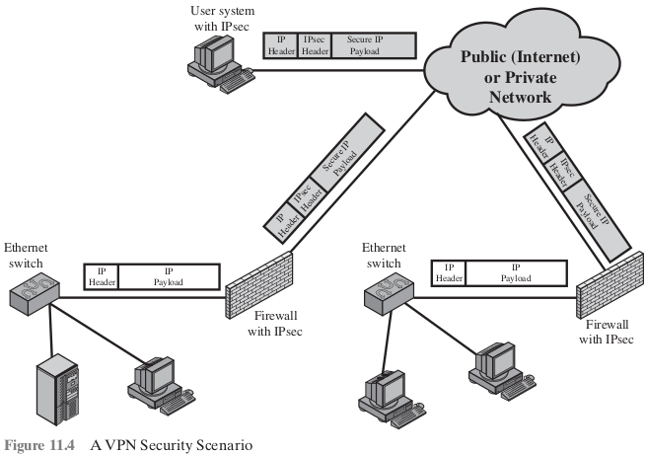
An establishment of both an internal and an external DMZ.
Web servers that need less protection because they have less critical information on them could be placed in an external DMZ, outside the external firewall.
What protection is needed is provided by host-based firewalls on these
Servers.
A distributed firewall is tasked with monitoring Security.

Slide 21
THANK YOU

